Slide 1
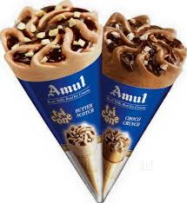
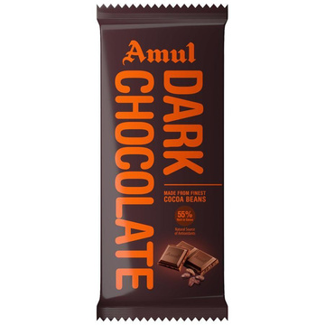
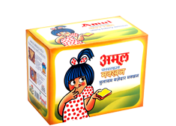
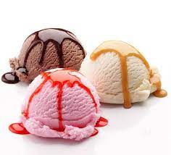
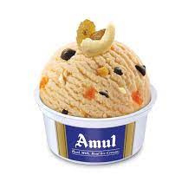
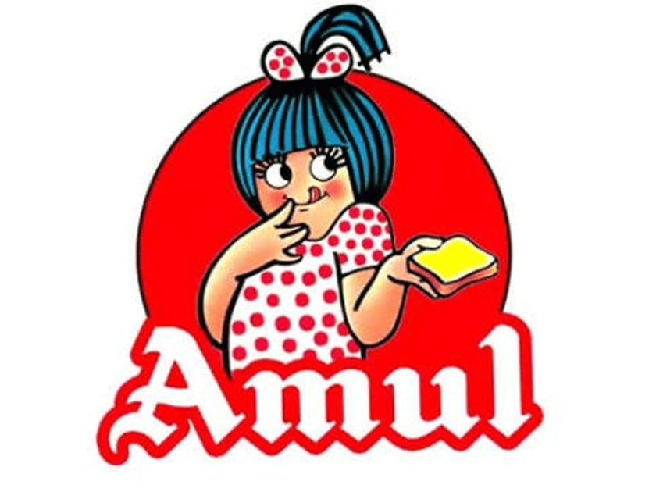
DIGITAL MARKETING PROJECT
Amul
Presented by:
Satya Degree & PG College
Ramya kommuru
Jhansi Gorle
Nikhitha Andhavarapu
Kiran Kumar Chandaka
Shabber Ali Shaik

Slide 2
Amul
GCMMF endeavour to satisfy the taste and nutritional requirements of the customer of the world through excellence in the marketing by the committed team. Through cooperative networking ,they are committed to offer quality product that provides best value for money.
MISSION :
The main USP of Amul is low pricining
To offer quality product at on affordable price
The competitive advertising is its “Backward integration strategy”
USP:
Brand
Tone:
Amul's tone, however, is always somewhat easygoing and friendly. They instill their brand and products by creating their own slang words.
Brand
Identity:
Amul is a renowned Indian dairy brand known for its innovative and memorable brand identity.
The Amul girl: One of the most iconic elements of Amul's brand identity is the adorable Amul girl.

Slide 3
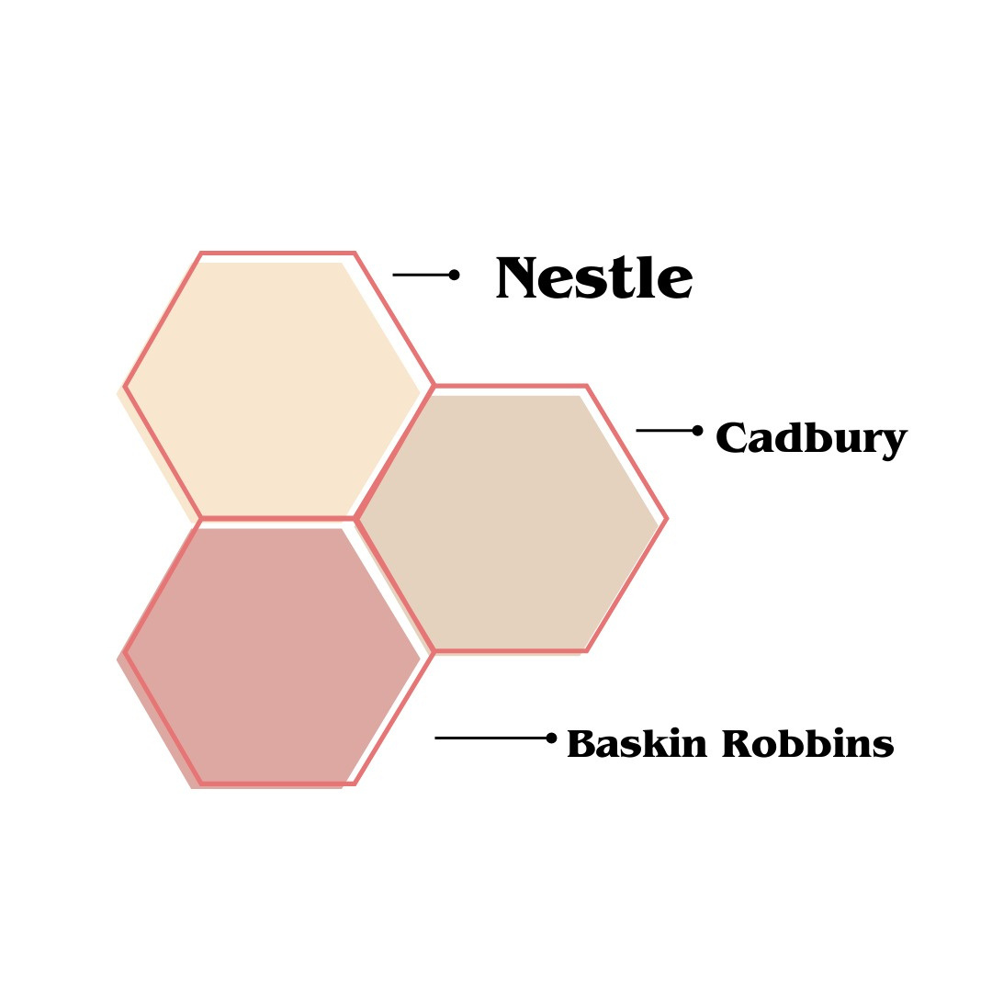

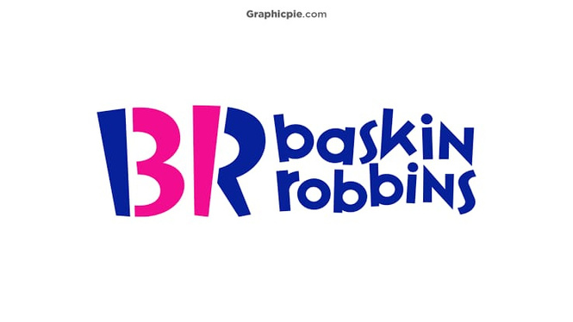
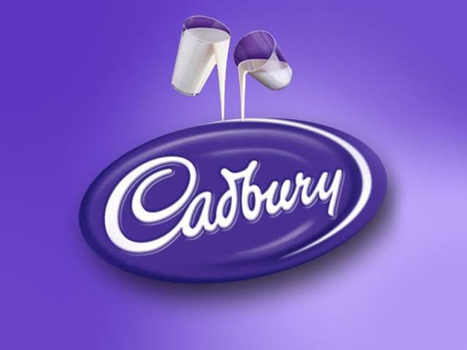
Competitor Analysis

Slide 4

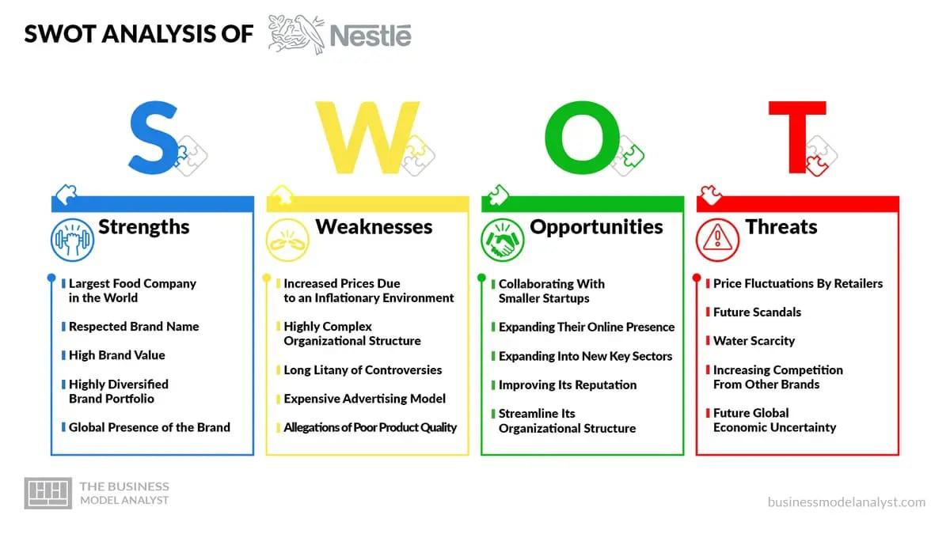
NESTLÉ
USP
Unique Selling Nestlé has concentrated all its nutrition, health and wellness of the society, and has been working towards enhancing the quality of life of people all around the world.

Slide 5
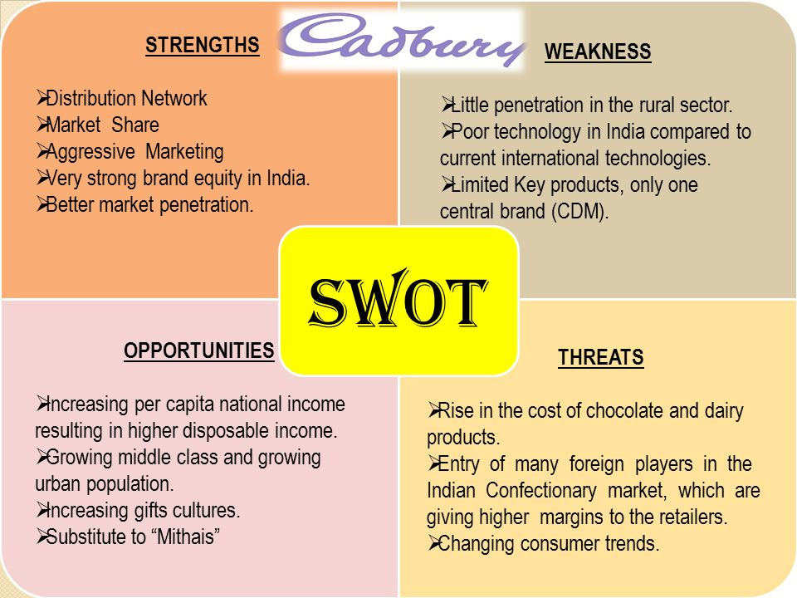
Cadbury
USP
The Cadbury chocolate bar USP is the creaminess of the milk chocolate and the use of the finest possible ingredients to create the product, making it as high quality as possible.

Slide 6
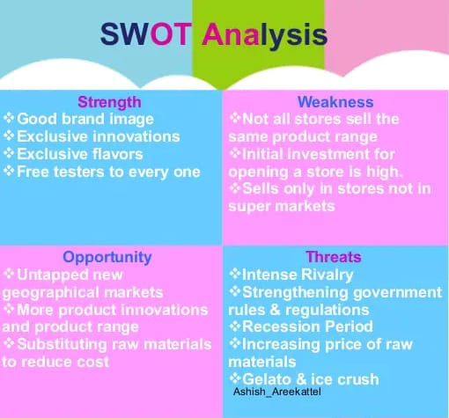
USP
Through the use of the premium ice cream, Baskin Robins will place its products in the grocery stores and shelves to differentiate them from the products from the ice cream stores. It will use the different 31 flavors as well as the premium ice creams to get the desired market share

Slide 7
Online Communication Channels
Nestle:
Face book, You tube, Twitter,Instagram, Pintrest, Linkedin
Cadbury:
Face Book & Instagram
Baskin-Robbins:
Baskin - Robbins mobile app

Slide 8
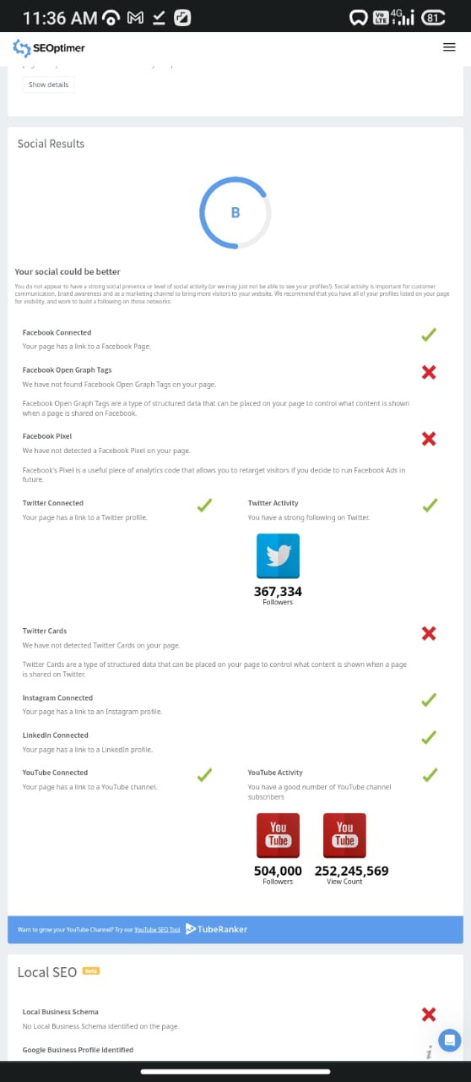
SEO Audit ( amul.com)

Slide 9
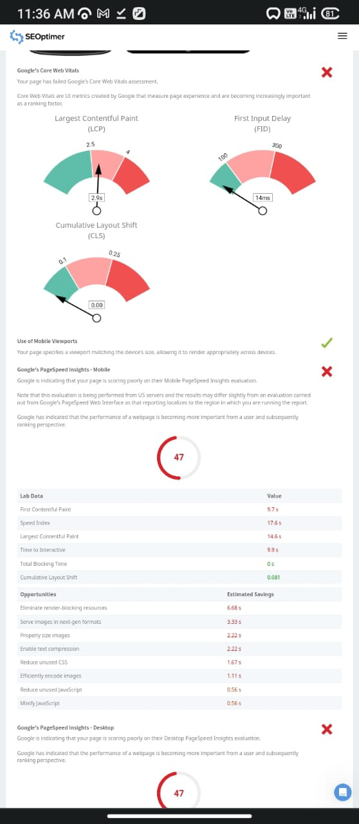

Slide 10
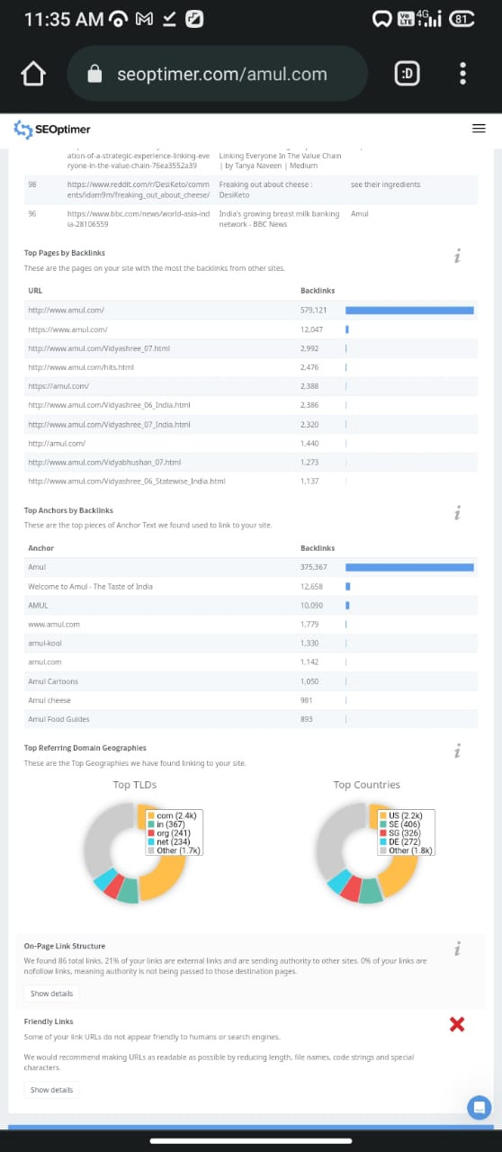
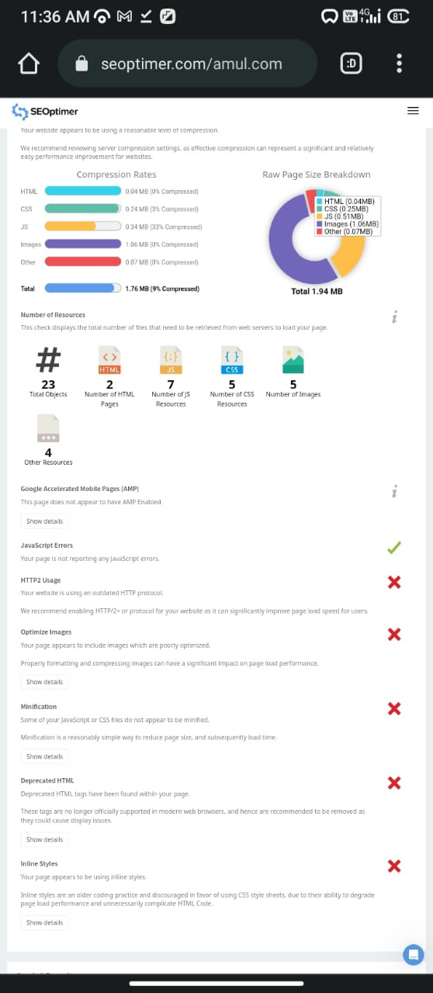

Slide 11
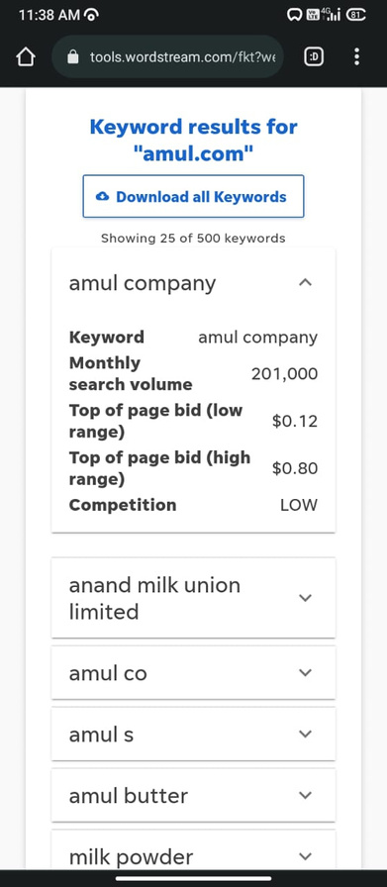
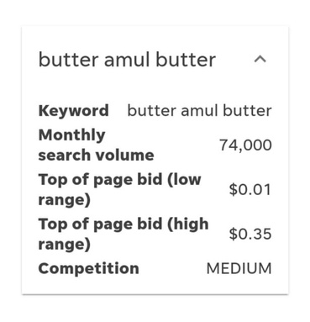

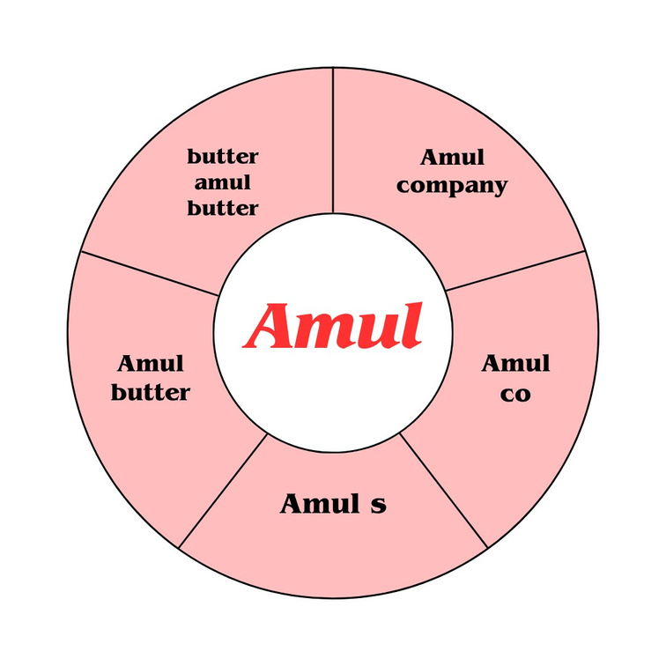
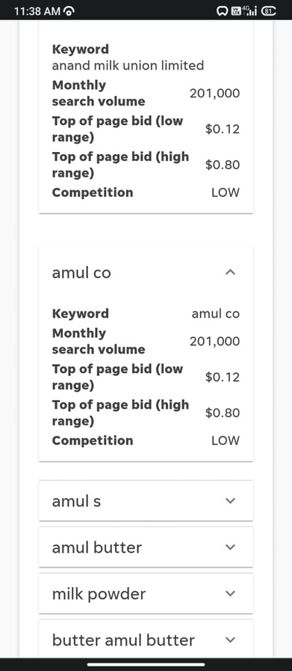
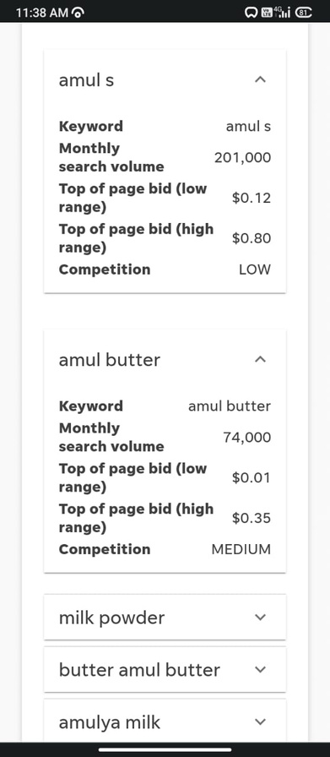
KEYWORD RESEARCH

Slide 12
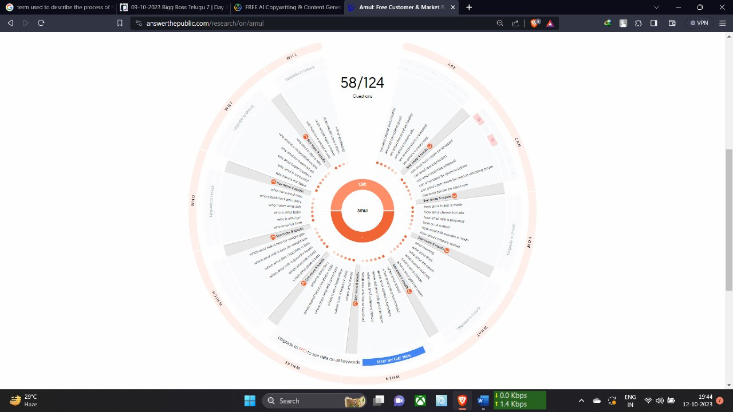
Long-tail keyword exploration

Slide 13
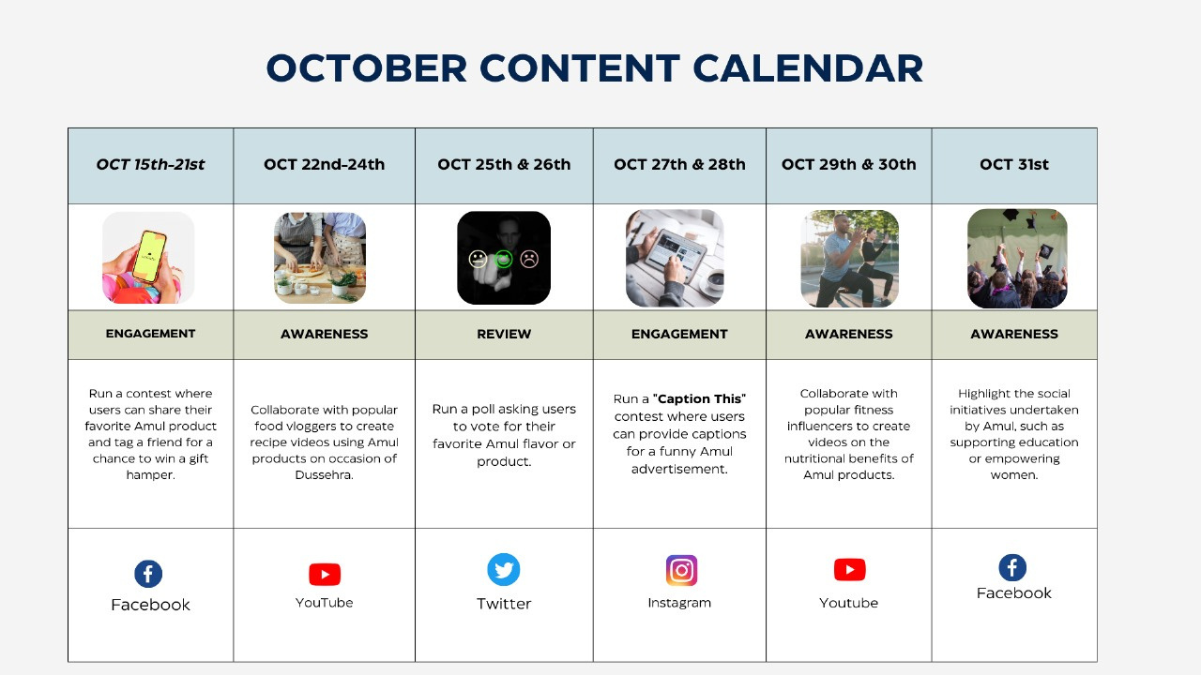

Slide 14
Content creation
Carousel - Instagram post
Reel on Amul - Instagram post
Post on Amul - Instagram

Slide 15
Instagram Story
Instagram story -1 highlight
Instagram story -2 highlight
Instagram Account link: amul_333_3

Slide 16
Thank
you!

